Slide 1
Welcome to Fundamentals of Data Storytelling
9:30 – 16:30

Slide 2
Troubleshooting
If I disconnect:
One of you will automatically become the host and when I return, I’ll resume the course.
Please don’t leave the session.
If you disconnect:
Don’t panic!
Re-join using your link.
Contact:
virtual.learningteam@qa.com
0203 908 2376
Chat link from your joining email

Slide 3
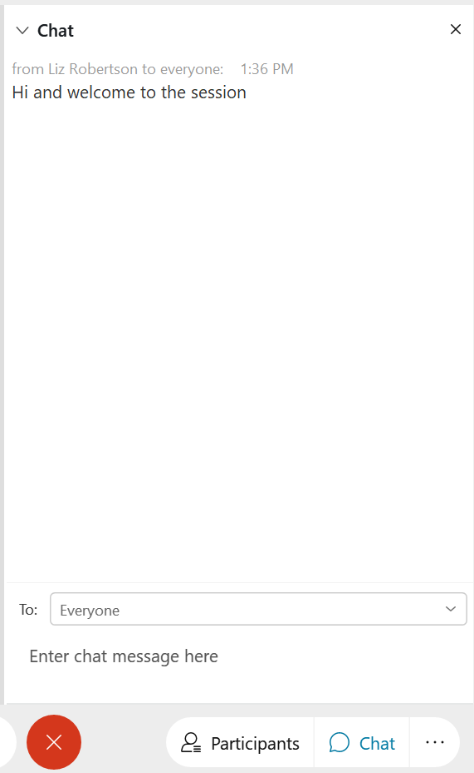
CHAT WINDOW
Ask and answer questions
Add comments

Slide 4
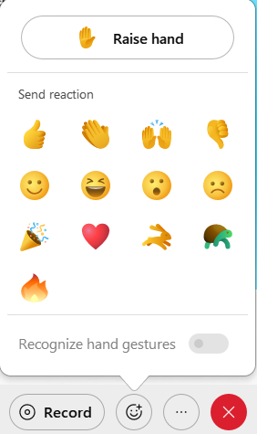
REACTIONS
AND RAISED HANDS
Finding a topic interesting?
Got a question?

Slide 5
Understand what data storytelling is.
Translate and clarify questions.
Understand what the question means and how to ask it better.
Work with underlying data quality.
Build a meaningful insight.
Define a hypothesis.
Identify the audience.
Build effective visuals.
Creating a compelling narrative.
Course topics

Slide 6

Questions?
Just ask!
Graphics by Storyset

Slide 7

Meet and greet
Your name
Your company and what it does
Role and key responsibilities
Specific aims for the course
Graphics by Storyset

Slide 8
What Sector do you work in…?
Government
Sales
Healthcare
Finance
Charity
Other
Transport
Education
IT

Slide 9
Basic
Expert
Intermediate
Your experience

Slide 10
Let’s get started…

Slide 11
Module 1:
What is data storytelling?
Why do data and analytics matter?
Benefits of data storytelling
Convert insight into information

Slide 12
REVIEW
Review activities
You can discuss these with your trainer or write down some ideas for the business.
Data for your stories – what data do you need for your reports in your organisation? Where is the data stored? How is the data accessed for your report?
Analytics for your stories – what analytics do you use on your data?
Your current insights – what insights do you have that need to be converted into information?

Slide 13
Module 2:
Asking better questions
What is a data question?
Translate and clarify questions

Slide 14
REVIEW
Review activity
You can discuss this with your trainer or write down some ideas for the business.
Your questions
What questions do you regularly get asked for your reports in your organisation? How do you currently tackle those questions? What will you now do differently?

Slide 15
Module 3:
Underlying data quality
Four main data qualities
  Filtered, gaps, specific, naming
Two main types of data
  Quantitative and qualitative

Slide 16
review
Review questions
You can discuss this with your trainer or write down some ideas for the business.
Your qualitative data
Do you have any data that is qualitative? What do you currently do with it? Would you do anything differently now that you are more aware of qualitative data?

Slide 17
Module 4:
Building an insight
What is a hypothesis?
Developing the hypothesis
Actionable insights

Slide 18
REVIEW
Review activity
You can discuss this with your trainer or write down some ideas for the business.
Your actions
What hypotheses have you formulated from your data analysis? How would you tackle those hypotheses? What insights are you developing? Overall, what are your main takeaways?

Slide 19
Module 5:
Identify the audience
Who is my audience
Empathy mapping

Slide 20
REVIEW
Review activity
You can discuss this with your trainer or write down some ideas for the business.
Your maps
Do you have any existing empathy maps or personas that you can use? Are there any you need to create?

Slide 21
Module 6:
Building effective visuals
Where can visualisations be used?
Visualisation types
Focus attention
Emphasis key points

Slide 22
REVIEW
(Part 1 of 2)
Review questions
Why is simplifying complex data important in data storytelling?
  A: to overwhelm the audience with information.
  B: to make the data more difficult to understand.
  C: to highlight only the critical insights and avoid distractions.
  D: to impress the audience with the depth of the data.
Fill in the blanks:
The matrix visualisation organises data into ____ and ____, just like a table, but it also includes additional dimensions for ____ or categorising the data.
True or false? A large and varied colour palette is visually pleasing and helps convey the information effectively.

Slide 23
REVIEW
(Part 2 of 2)
Review activity
You can discuss this with your trainer or write down some ideas for the business.
Your visuals
How do you declutter your visualisations? What type of focus may you need to use? What types of visualisations do you need to develop for your audience?

Slide 24
Module 7:
Creating a narrative
Data narrative arc – telling the story!
Build a storyboard

Slide 25
review
Review activity
You can discuss this with your trainer or write down some ideas for the business.
Your actions
What storyboards do you need to create? How are you going to foster an emotional connection?

Slide 26
Let’s
Review

Slide 27
Understand what data storytelling is.
Translate and clarify questions.
Understand what the question means and how to ask it better.
Work with underlying data quality.
Build a meaningful insight.
Define a hypothesis.
Identify the audience.
Build effective visuals.
Creating a compelling narrative.
Course topics

Slide 28

What Are You going to:
Stop?
Continue?
Start?

Slide 29
Congratulations and Thank You
You will receive your course attendance certificate via email.

